Slide 1
Workshop 9
Advanced Stream Processing Pipelines
Building Real-Time Weather Data Analytics
Notes:
Welcome: Welcome to Workshop 9 where we'll explore advanced stream processing pipelines. Over our previous workshops, we've worked with data in different ways, from making it quickly available for analysis (workshop 5) to processing periodic updates in batch (workshop 7). Today, we get to physically try real-time data processing.
AWS but universal concepts: Before we start, I want to emphasise that while we'll be using AWS tools today, the concepts we'll cover are universal. Whether your organisation uses Azure, Google Cloud, or open-source solutions like Apache Kafka, the patterns and principles we'll explore will apply across all these platforms.
Streaming is like a river of data: Think of stream processing like a river system. Just as a river continuously flows, collecting water from various tributaries and delivering it to different locations, our data streaming system will continuously collect data from sources, process it, and deliver it to various destinations for analysis. Today we'll build this kind of system step by step.
Today’s scenario / use case: Weather data monitoring at precise geo locations: For our example, we'll use weather data monitoring as our example, but the patterns we develop could just as easily apply to financial transactions, IoT sensor readings, or any situation where immediate data processing adds value. I encourage you to think about your own organisation and project as we progress through the workshop. Consider how these streaming patterns might enhance your current batch processes or enable new capabilities in your data platforms.
Do no panic! EPA/IFATE does not require streaming! However, to be clear you are not required to demonstrate streaming in your project, only knowledge of it in relation to your organ
IFATE? The workshop will help you with many Pass Descriptors but let’s briefly focus on two important ones it can help you with.

Slide 2


Workshop Alignment with IFATE Pass Descriptors
Professional Discussion: Describes how they use data ingestion frameworks such as streaming, batching and on-demand services to move data from one location to another in order to optimise data ingestion processes. (K18, S15)
K18: How to use streaming, batching and on-demand services to move data from one location to another.
S15: Optimise data ingestion processes by making use of appropriate data ingestion frameworks such as batch, streaming and on-demand.
Data engineer / Institute for Apprenticeships and Technical Education
Notes:
Knowledge of streaming, batch and on-demand: This workshop can help you consider how you would helps you demonstrate knowledge of streaming, and in contrast to on-demand and batch.
Contrast streaming to batch: Throughout today, we will get practical experience with streaming data - building a pipeline that continuously collects and processes weather data. This is different from the batch processing you've used before, and we'll discuss when each approach makes sense.
Matching ingestion pattern to business need: You'll learn how to match the right ingestion pattern to business needs. Sometimes real-time data is essential, like monitoring critical equipment temperatures. Other times, batch processing is more efficient. Understanding these trade-offs is important.
Optimisation: Finally, when it comes to optimisation, you'll implement several practical techniques. You'll set up smart data partitioning by location and time in S3 to improve query performance. And write efficient Athena queries that leverage this partitioning. These are just two examples. As we go through look out for other optmisation approaches we do take or you could include.

Slide 3
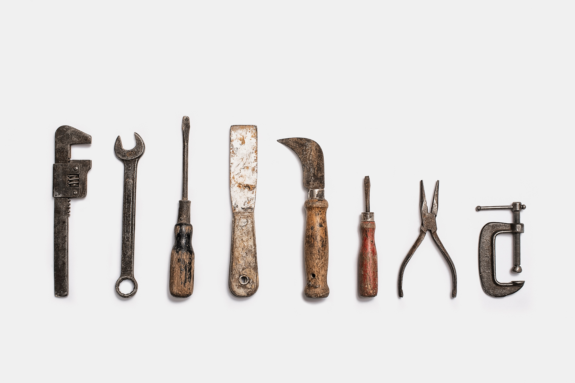
Workshop Alignment with IFATE Pass Descriptors
Project: Describes the types and uses of data engineering tools in their own organisation and how they apply them. (K20)
K20 Types and uses of data engineering tools and applications in own organisation.
Data engineer / Institute for Apprenticeships and Technical Education
Notes:
Tool categories in streaming: This workshop helps you understand the main categories of tools needed in streaming architectures - data collection, message broking, stream processing, and analytics. While we use specific AWS tools today, these categories exist across all platforms.
Universal patterns across platforms: Today we'll see how producers feed data to message brokers, which buffer it for consumers. This same pattern appears whether you're using AWS Kinesis, Azure Event Hubs, or Apache Kafka. Understanding these universal patterns helps you evaluate tools in your own organisation.
Different tools for different needs: You'll learn how different tools serve different purposes in a streaming architecture. For instance, some tools are for collecting data, others at processing it, and others at analysing it. This helps you understand how to select appropriate tools for specific tasks in your projects.
Practical implementation for your organiiasotins tools: While we use AWS services, the knowledge and experience can help you describe our own organisations tools regardless of your technology stack. Look out for how each tool type could map to equivalent services in your organisation!

Slide 4

Building on Previous Workshops
Three Phases of Your Learning:
Workshop 5: On-Demand Data Analysis
Workshop 7: Automated Batch Updates
Today: Real-Time Stream Processing
Notes:
Workshop journey context: We've been building up to stream processing through a deliberate sequence of workshops. Each one adds complexity but builds on familiar concepts from previous sessions.
Workshop 5 foundations: Here we focused on making data rapidly available for analysis. You transformed CSV files into optimised Parquet format, used Glue to automatically discover schemas, and enabled quick analysis through Athena's serverless querying. Today, we'll use these same data lake patterns but adapt them for streaming data.
Workshop 7 progression: In workshop 7, we tackled the challenge of keeping analytical data current as source systems change. Using the Sakila DVD rental database, we built automated pipelines to detect changes and update our dimensional model. Today, we'll move from periodic batch updates to continuous streaming.
Today's evolution: Instead of waiting to gather changes and process them with a regular pattern (daily, weekly, monthly), we'll build a pipeline that can processes data in real-time as it arrives. Our weather monitoring system will demonstrate how to: Ingest data continuously vs periodic batch loads. Process records immediately vs scheduled updates. Enable multiple downstream consumers to analyse the same data stream. Support both real-time analytics and historical querying.
Look out for similarities: As we progress today, notice how streaming builds on concepts you already know, including optimised storage formats (parquet) to change detection. The main difference is the continuous nature of processing our data.

Slide 5
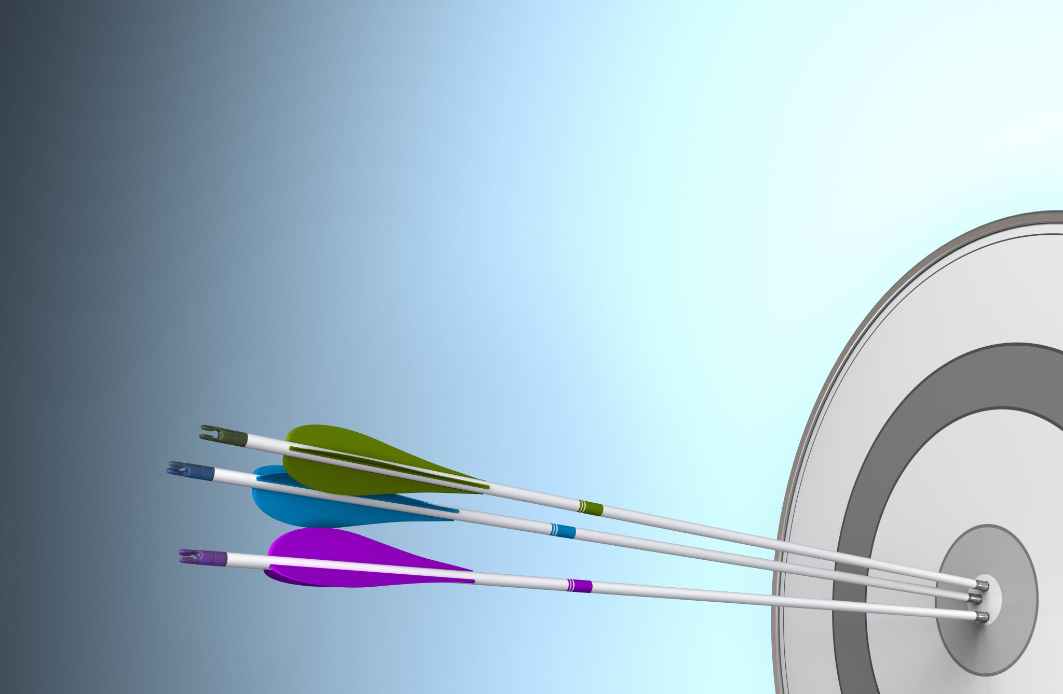
Workshop Objectives
By the end of today, you will have:
Built a Complete Streaming Infrastructure
Created an Automated Data Collection System
Developed Real-Time Processing Pipelines
Implemented Analytics on Streaming Data
Notes:
Complete streaming solution: Today you'll build a full streaming architecture from end to end. While we use AWS services, the patterns apply to any streaming platform. You'll see how producers and brokers work together in a streaming solution.
Automated collection system: You'll create an automated system that pulls weather data every minute using Lambda and EventBridge. Consider how this pattern could apply to other real-time data sources like IoT sensors or financial transactions in your own projects.
Resilient pipeline design: The pipeline you'll build includes important production features such as automatically partitions data for efficient querying.
Analytics capabilities: You'll enable both real-time and historical analysis and consider the differences between them.
Look out for opportunities: Throughout the workshop, consider how these patterns might apply to streaming needs in your organisation. Could streaming solve any current data freshness challenges? Would near real-time processing provide business value?

Slide 6

Morning activity
Building the pipeline

Slide 7

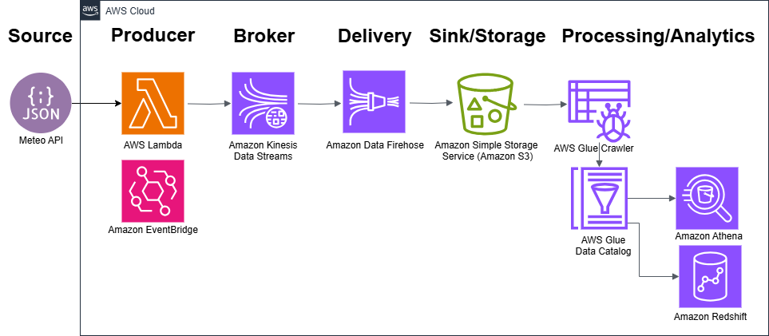
What We'll Build
🌡️ Real-Time Data Collection from Weather API
⛓️ Resilient Stream Processing Pipeline
📈 Comprehensive Analytics Platform
Notes:
End-to-end architecture: We're building a complete streaming solution for wind farm temperature monitoring. The architecture shows how we'll move from collecting temperature readings through to analysis that could prevent turbine damage and optimise maintenance schedules.
Producer layer details: At the start of our pipeline, we have: Weather API simulating temperature sensors on turbines. Lambda function checking temperatures every minute. EventBridge ensures we never miss a reading. In a production wind farm, this layer would connect to real turbine sensors, but the pattern remains the same. We call this our Producer.
Data movement approach: The middle of our pipeline ensures reliable temperature monitoring through: Kinesis Data Streams buffering real-time temperature readings into what’s called our Broker. Kinesis Firehose manages Delivery to storage, called our Sink. S3 stores all temperature history for analysis This approach ensures no temperature spikes are missed that could indicate turbine issues.
Analytics capabilities: The final part enables wind farm operators to: Automatically catalogue temperature data with Glue. Query historical patterns with Athena. Build maintenance forecasts with Redshift. These tools help operators make data-driven decisions about turbine maintenance and operation.
Look out for patterns: Throughout today, notice how this architecture could support key wind farm needs: Immediate alerts for dangerous temperatures. Historical analysis for maintenance planning. Multiple teams accessing the same data While we're monitoring just three locations today, these patterns would scale to hundreds of turbines. Also, think about how this use case could be equivalent to a business process in your organisation where ingesting the data in real time could have strong busiess uses.

Slide 8
Workshop Flow
Morning
Building the Pipeline
CloudFormation deployment
Understanding Lambda as the producer
Exploring Kinesis Data Streams
Kinesis Firehose and S3 as the sink
Cataloguing with Glue
Querying data in Athena
Going Further (time permitting)
Orchestrated data pipelines with Glue workflows
Creating data architecture diagrams with Draw.io or AWS Icons
Exploring direct streaming patterns with Kinesis, Glue, and Redshift
Afternoon
Workshop Reflection
What went well?
Technical challenges?
Learning points and insights?
Project and Organisational Knowledge Application
Evaluating where streaming fits in your project or organisation
Applying batch vs. streaming in business scenarios
Notes:
Morning
Building the Pipeline
- We'll begin by setting up the environment using CloudFormation. This will automate the deployment of the streaming architecture, saving time and ensuring consistency.
- Next, we'll examine Lambda as the producer, which collects temperature data from a weather API. It represents the turbines in a real wind farm setup.
- We'll then look at Kinesis Data Streams, which buffer the incoming temperature readings in real-time, ensuring no data is lost.
- Following this, we'll look at Kinesis Firehose, which delivers the buffered data to S3 as the sink, where the data is stored for analytics and historical review.
- We'll also use AWS Glue to catalogue the data, making it queryable and accessible for downstream analytics.
- Finally, we'll explore Athena, which allows us to query the historical data directly from S3 to uncover trends and insights.
Going Further (time permitting)
- If time allows, we'll explore orchestrating data pipelines with Glue workflows, automating the end-to-end process for regularly updating data in Redshift.
- We'll also look at creating data architecture diagrams using tools like Draw.io or AWS Icons, helping visualise complex workflows and making collaboration easier.
- Finally, we'll discuss direct streaming patterns with services like Kinesis, Glue, and Redshift, which enable low-latency ingestion and analytics.
Afternoon
Workshop Reflection
- We'll reflect on the morning session:
- What worked well in the pipeline setup and processes?
- What technical challenges did you encounter?
- What are your key learning points or insights from the exercises?
Project and Organisational Knowledge Application
- We'll wrap up by discussing how streaming applies to your projects or organisation:
- Consider where streaming architectures could solve current business challenges or improve data freshness.
- Evaluate how batch vs. streaming might apply to specific business use cases, balancing complexity with business value.

Slide 9
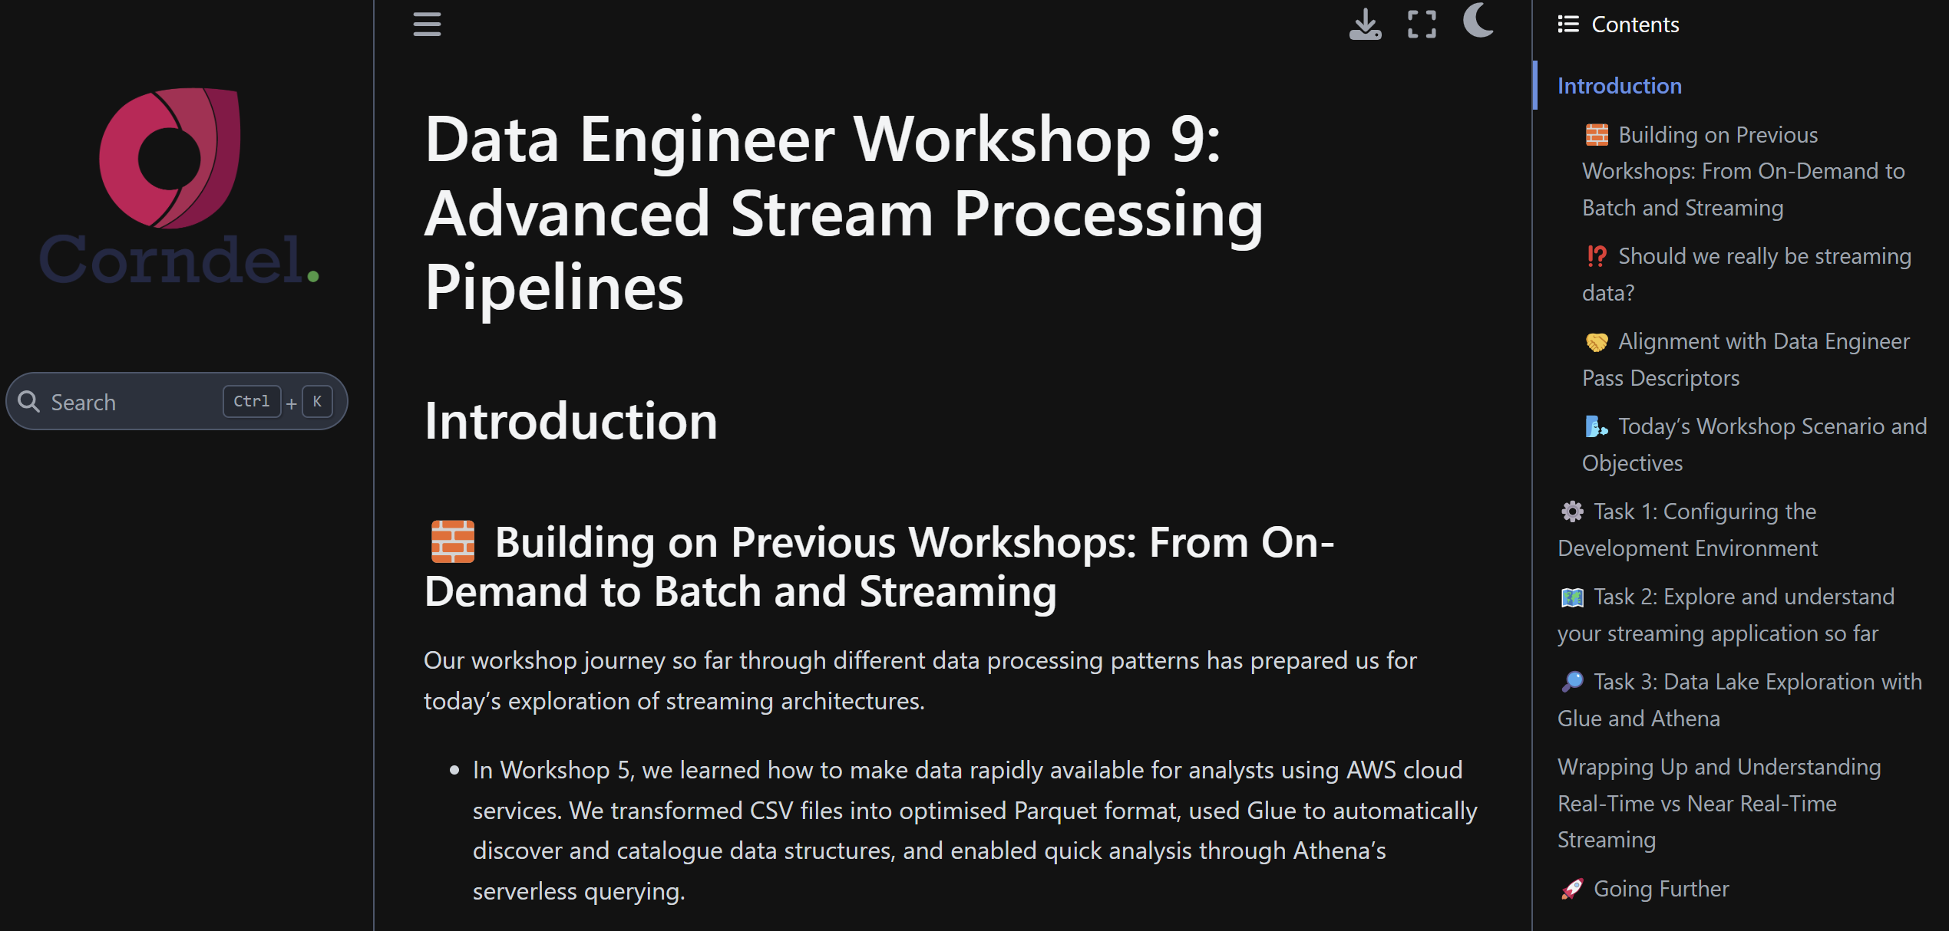
Workshop Instructions: Your Step-by-Step Guide
Key concepts and terminology
Task breakdown and dependencies
Optional "Going Further" sections
How to ask for help
We will now walk through the document structure and highlight how each section builds on the previous one to create a complete pipeline
Notes:
- Our workshop guide breaks down tasks and concepts into clear, manageable sections.
- Each section builds on the previous one, enabling us to create a complete streaming pipeline by the end.
Key concepts and terminology: Ensure you understand the foundational terms and ideas presented in each step.
Task breakdown and dependencies: Follow the logical order of tasks, as each depends on successful completion of the previous one.
Optional "Going Further" sections: Explore these if you have extra time to deepen your understanding of advanced topics.
How to ask for help: Use the provided resources or ask your PDE if you have any issues during any step.
- We’ll now walk through the document structure, highlighting how each section builds on the last.
- Focus on understanding how the pipeline connects from ingestion to analysis.

Slide 10

Afternoon activity
Reflecting on the morning activity and how it might apply to your project or organisationtion

Slide 11
Workshop reflection
⚙️Technical Implementation
1 ✨Which parts of the pipeline came together smoothly?
2 🚧Where did you encounter challenges?
🛣️Learning Journey
1 💡What key concepts clicked today?
2 🤔 Which concepts need more exploration?
3 🔎What debugging approaches worked best?
3 ⚖️How does this compare to any previous pipeline work?
Notes:
- This activity focuses on reflecting on your progress and identifying areas for improvement.
- We’ll explore two key areas: Technical Implementation and your Learning Journey.
Technical Implementation
1. Smooth Parts:
- Which components of the pipeline came together without much effort. Was it setting up the producer or querying the data in Athena?
2. Challenges:
- Where did you face problems. Were there issues with deployment, debugging, or understanding a service?
3. Debugging Successes:
- Reflect on what debugging strategies worked best. Did you rely on logs, testing specific steps, or asking for support?
Learning Journey
1. Key Concepts:
- What "aha" moments did you have today? Did streaming or cataloguing concepts finally make sense?
2. Areas for Exploration:
- What concepts that still feel unclear or require deeper exploration. Would reviewing Kinesis or Glue help solidify your understanding?
3. Comparison to Past Work:
- How does this pipeline exercise compare to any previous experience you’ve had with data engineering workflows?

Slide 12
Streaming in your Project or Organisation?
📄 In your project
2️⃣ 📈 Would your project and its business use benefit from real-time insights, such as IoT sensor data, fraud detection, contact centres, sales, or live monitoring of data sources of any kind?
🏢 In your organisation
1️⃣ ☁️ Does your organisation use streaming frameworks already or is testing them or has plans to use them (e.g., Kinesis, Kafka, Azure Streaming Analytics)?
3️⃣ 🔁 Could streaming enhance batch processing in your pipeline? For example, by providing immediate updates to real-time dashboards, while batch processing handles larger-scale aggregations and historical data summarisation? Even if only in theory?
1️⃣✨ Is streaming already implemented in your project, or are you testing it as a proof of concept to gauge its potential?
2️⃣ 🏢 If your organisation doesn’t use streaming what real-time scenarios could benefit from it?
3️⃣ ⚠️ What challenges might your organisation face in adopting streaming (e.g., cost, skill gaps, infrastructure limitations)?
Notes:
This slide prompts reflection on how streaming fits within both your project and organisation. We'll explore practical applications, potential benefits, and barriers to adoption. Use this discussion to connect streaming concepts to your real-world scenarios.
In Your Project
1. Is streaming implemented or in a proof-of-concept phase?
- Consider if your project has already adopted streaming. If not, is there scope to test its potential? Discuss where streaming might align with your project goals, even if only as an experiment.
2. Does your project need real-time insights?
- Reflect on specific scenarios like IoT sensor data, fraud detection, or live monitoring. Could these capabilities enhance your project’s outputs or support critical decision-making in real time?
3. Could streaming complement batch processing in your project?
- Explore how streaming could work alongside batch processes. For example:
- Streaming updates real-time dashboards with immediate data.
- Batch processing deals with large-scale aggregations and historical trends.
- Even if you wouldn’t add streaming, consider where a hybrid model might add value.
In Your Organisation
1. Does your organisation use or plan to use streaming frameworks?
- Think about technologies like Kinesis, Kafka, or Azure Streaming Analytics. Are these tools in use or under consideration? What use cases are driving or could drive adoption?
2. If streaming isn’t used, what real-time scenarios could benefit?
- Reflect on areas where real-time data could transform processes—for example, improving customer experiences, reducing delays in operations, or enabling faster responses in critical systems.
3. What challenges could hinder adoption?
- Discuss barriers like:
- Costs of implementing and maintaining streaming pipelines.
- Skills gaps—does your team have the expertise required?
- Infrastructure limitations—can your systems deal with the data velocity and volume from the data sources it could be useul for?
Wrap-Up:
Encourage learners to connect these points to their organisation and project. They should identify potential opportunities or gaps where streaming could play a transformative role and consider whether the benefits outweigh the challenges.

